Slide 1
Brain stroke Detection

Slide 2
Introduction
Stroke has become a major health issue in recent years . A stroke is a neurological disorder caused by ischemia or bleeding of the brain arteries which is known as a cerebrovascular accident .
It frequently causes a slew of physical and cognitive issues that make functioning difficult [8]. Figure 1 shows the utmost neoteric worldwide health estimates by cause from 2000 to 2016.
Because of its high mortality rate, the American Heart Association recognizes stroke to be a superior health condition. Early stroke identification is critical for optimal treatment, and ML can aid in this process.
Machine learning (ML) is the most advanced technology for assisting clinicians in making clinical judgments and forecasts.
ML has been pre-owned in manifold research over the last meager decennary to upgrade the veracity and well-timed stroke interpretation.

Slide 3
Problem Statement
Ischemic stroke occurs when a blood clot blocks or narrows an artery leading to the brain. A blood clot often forms in arteries damaged by the buildup of plaques It can occur in the carotid artery of the neck as well as other arteries. This is the most common type of stroke.

Slide 4

Scope and Objectives
Scope:
The model will enable healthcare providers to better identify the origins of blood clots in deadly strokes, making it easier for physicians to prescribe the best post-stroke therapeutic management and reducing the likelihood of a second stroke.
Objective:
The main goal here is to distinguish between the two major Acute Ischemic Stroke subtypes:
Cardio embolic and Large Artery Atherosclerosis.
2. To prevent the blood clot from getting larger or breaking loose. Treatment can reduce your chances of developing more blood clots in the future. Treatment depends on where the blood clot is and how likely it is to harm

Slide 5
Literature Review
Published Year | Title | Summary
2019 | Voxel Based Lesion Segmentation Through SVM Classifier for Effective Brain Stroke Detection | Stroke image is carried out through the Support Vector Machine Classifier with Adaptive Multi thresholding Technique. Accuracy: 88%
2021 | Brain Stroke Detection from MRI Image using Logistic Regression Classifier | In this paper an efficient model for brain stroke detection from magnetic resonance imaging (MRI) using machine learning approach namely logistic regression classifier is proposed. The MRI images are pre-processed to reduce noise and converted into gray images. Accuracy:80%

Slide 6
Literature Review
Published Year | Title | Summary
2022 | Developing a Predictive Model of Stroke using Support Vector Machine | The model is evaluated using accuracy, precision, recall, F1 score, and area under curve.The study used datasets of 500 patients from Cavite, Philippines. Used SVM model with accuracy 85%.
2022 | Detection of Blood Clots inside the Brain using Microwave Imaging. | a microwave head imaging system is utilized for the detection of blood clots inside the brain. The imaging plane is divided into four quarters, and each quarter is scanned for imaging.(It is a hardware model like MRI machine)

Slide 7
Requirement Specification
Interfaces
User: Application Based stroke Blood Clot Detection.
Software Requirement
IDE : Spyder
Coding Language : Python Version 3.8
Operating System : Windows 10
Hardware Requirement
Processor : Intel i5 Processor
Speed : 1.1 GHz
RAM :8 GB
Hard Disk : 40 GB
Key Board : Standard Windows Keyboard
Mouse : Two or Three Button Mouse
Monitor : LCD/LED

Slide 8
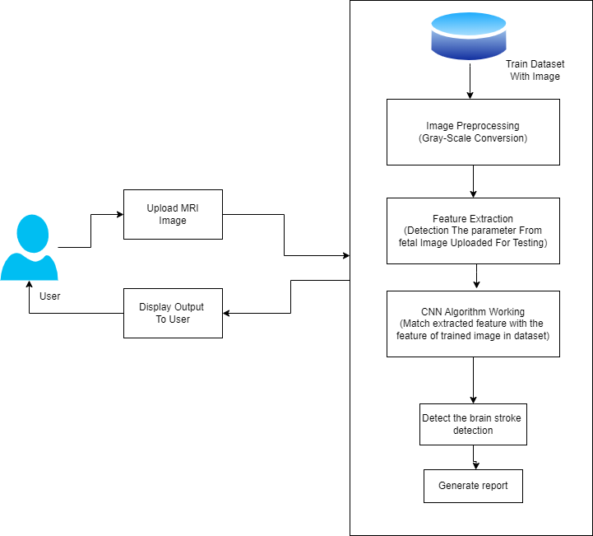
System Architecture

Slide 9
Methodology
Preprocessing:
The training dataset consists of Whole Slide Digital pathology images which are massive in file size due to their high resolutions. So,we are shrinking the dataset down from ~356 gigabytes down to a few gigabytes.
Model Training (Building):
Training the model using CNN(Convolutional Neural Network).
Model Testing:
Testing the model by predicting the targets as Cardio Embolic(CE) or Large Artery Atherosclerosis(LAA)

Slide 10
Conclusion:
In this System we have used CNN algorithm. And it gives more accuracy.first we train model then test and last give output for Blood stroke Clot detected .

Slide 11
References
Subudhi, Asit; Sahoo, Sanatnu; Biswal, Pradyut; Sabut, Sukanta (2018). SEGMENTATION AND CLASSIFICATION OF ISCHEMIC STROKE USING OPTIMIZED FEATURES IN BRAIN MRI. Biomedical Engineering: Applications, Basis and Communications, (), 1850011–
Marko Wilke; Bianca de Haan; Hendrik Juenger; HansOtto Karnath (2011). Manual, semi-automated, and automated delineation of chronic brain lesions: A comparison of methods. , 56(4), 2038–2046.
Merino, J. G. (2014). Clinical stroke challenges: A practical approach. Neurology: Clinical Practice, 4(5), 376–377.
Johnson W, Onuma O, Owolabi M, Sachdev S. Stroke: a global response is needed. Bulletin of the World Health Organization 2016;94. https://doi.org/ 10.2471/BLT.16.181636.634634A
heart, N., lung, & institute, b. (2015). Stroke. https:// www.nhlbi.nih.gov/health-topics/stroke. [Online; accessed on 24-Jan-2020].

Slide 12
THANK YOU !!

